Slide 1
Python behave BDD framework

Slide 2
What is BDD?
behave is behaviour-driven development
Behavior-driven development (or BDD) is an agile software development technique that encourages collaboration between developers, QA and non-technical or business participants in a software project.

Slide 3
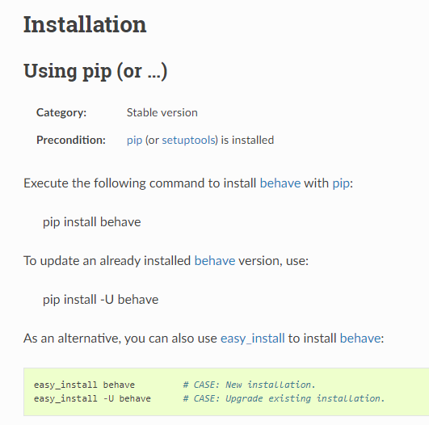
Installation process

Slide 4
Automation Libraries
With behave you can test anything on your application stack: front-end behavior, RESTful APIs, you can even drive your unit tests using Gherkin language. Any library that helps you with that you usually integrate by adding start-up code in before_all() and tear-down code in after_all().

Slide 5
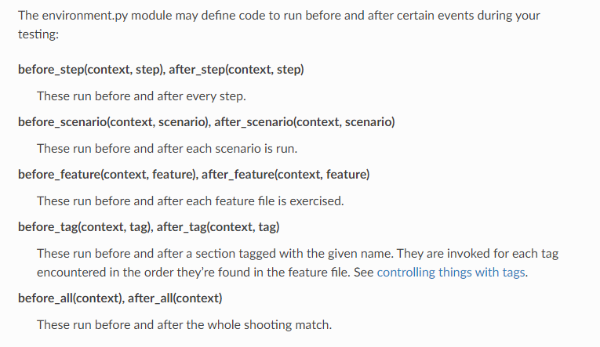
Environmental Controls

Slide 6
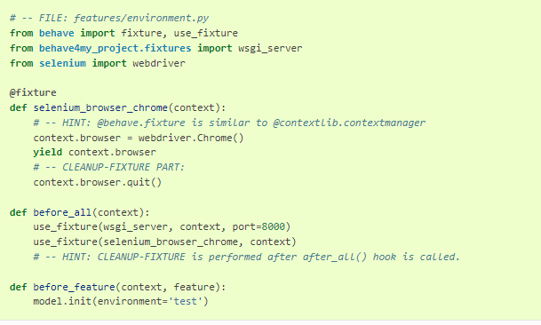
Common Use case

Slide 7
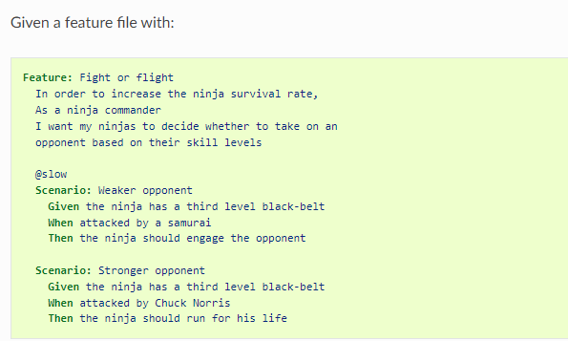
Feature file

Slide 8
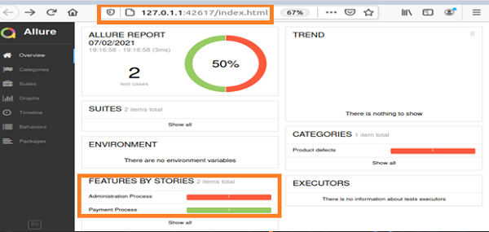
Allure Report
pip install allure-behave

